Slide 1
Age estimation project
Middle presentation

Slide 2
Environment & tools
Intel real-sense camera & SDK.
Python \ CPP programming language.
OpenCV python library for image processing.
Pose Estimation Algorithms such as OpenPose, AlphaPose, Cubemos, etc.
Nexus Vicon

Slide 3
Original goals
Analyzing depth videos captured by intel real-sense camera where people in a variety of ages doing exercise.
The analyzation includes image detection methods, pose estimation AI, and algebra calculations in order to produce relevant data for the Age Estimation research.
Our goal is to extract accurate researchable data from the captured videos.

Slide 4
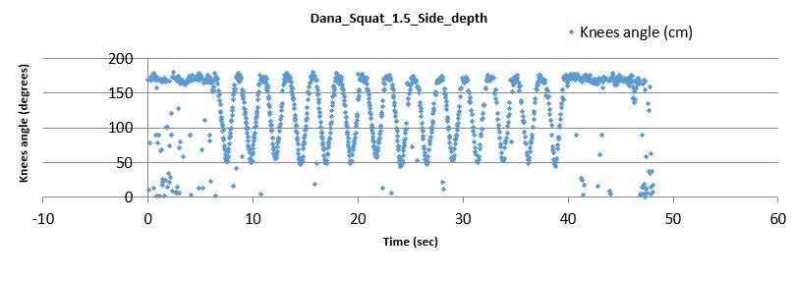
Progress
We’ve established a working pipeline which includes: data collection from Realsense depth cameras, skeleton extraction, angle calculation and results display.
alphapose

Slide 5
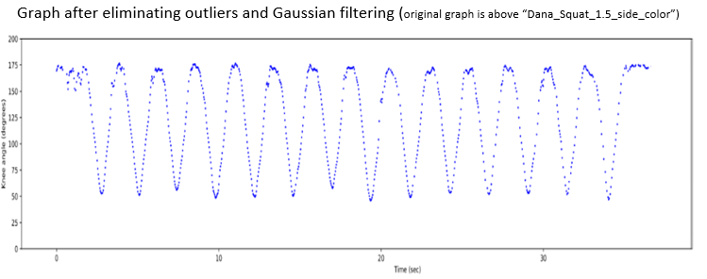
progress
Cleaning the graphs from noise and outliers
Knee Angle (degree)
Time (sec)

Slide 6
progress
Created visualization of data –motion video of patient with visual presentation of what we’re calculating, next to a graph of the collected data.

Slide 7
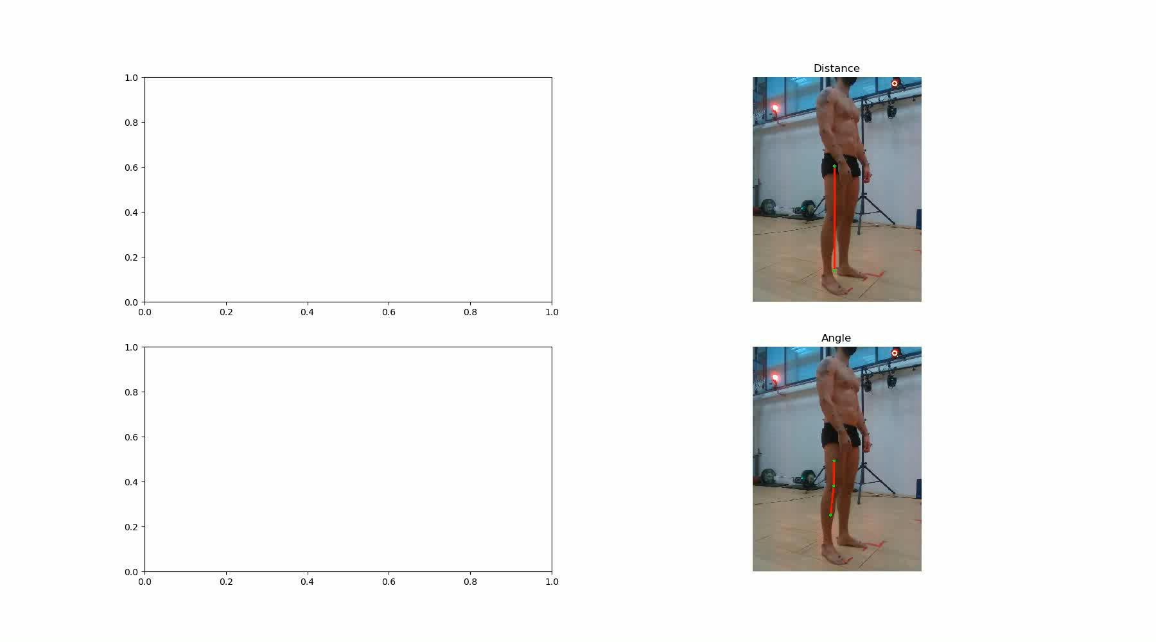

Slide 8
Progress
Started using OpenPose as it gives good results after rotating the frames in the right direction.
Comparing data from Realsense with pose estimation to Vicon data

Slide 9
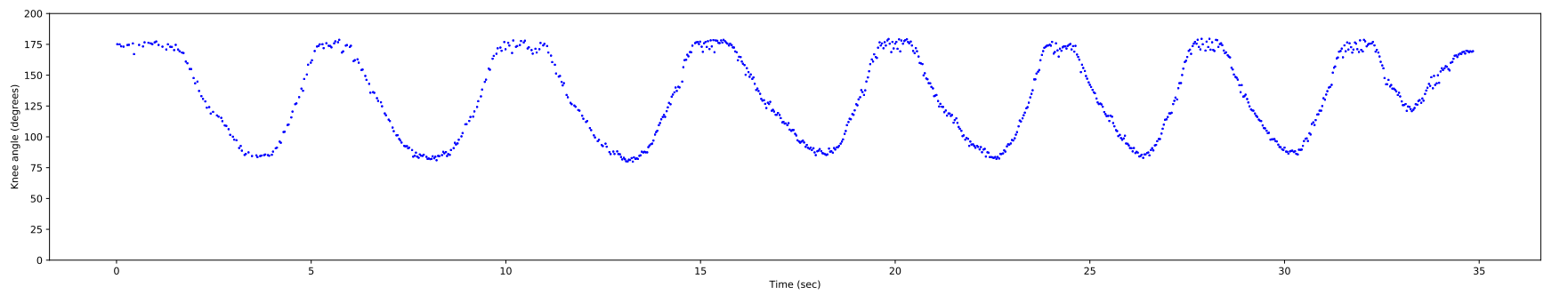
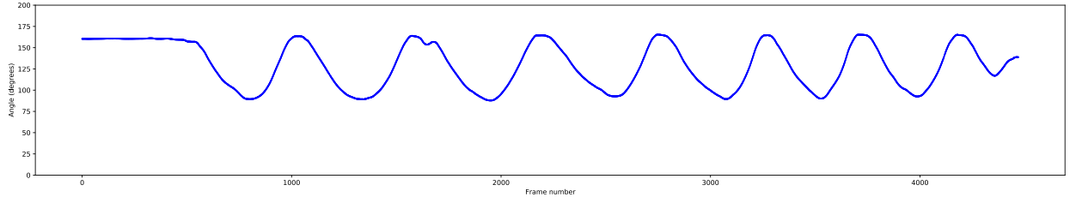
Subject doing squats, side view, right knee angle (OpenPose)
Knee Degree (degree)
Time (sec)
Subject doing squats, right knee angle (Vicon)
Knee Degree (degree)
Frame

Slide 10
Current challenges
Different skeleton keypoints from OpenPose and Vicon
Outer projection keypoints compared to “real” depth keypoints of Vicon
Vicon has no timestamps
Collecting new data is now limited due to Corona

Slide 11
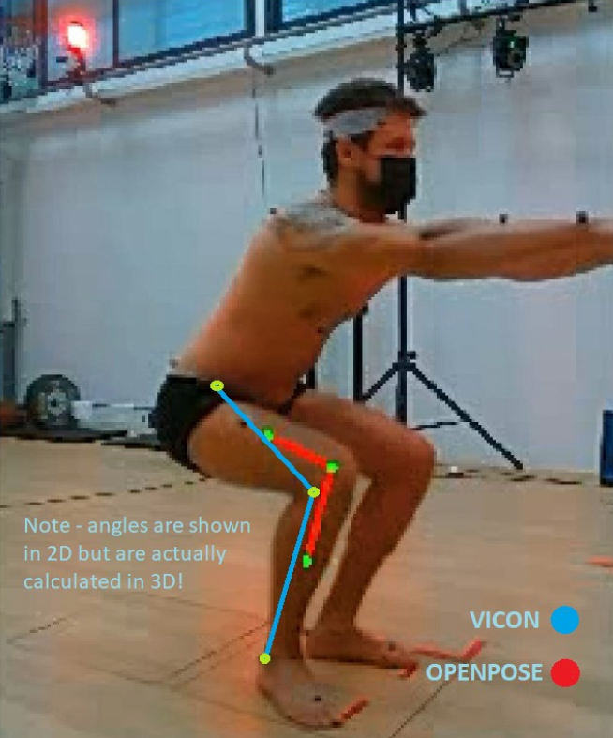
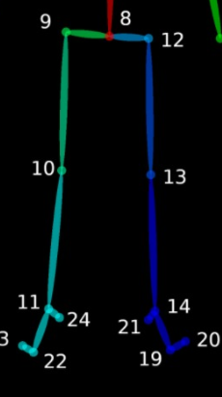
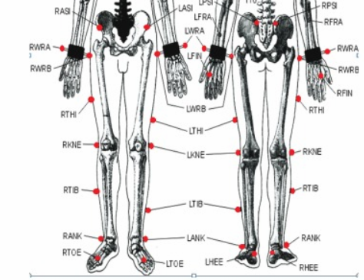
- Different markers
- Outer vs inner keypoints
- Different markers
- Outer vs inner keypoints
OpenPose skeleton
Vicon skeleton

Slide 12
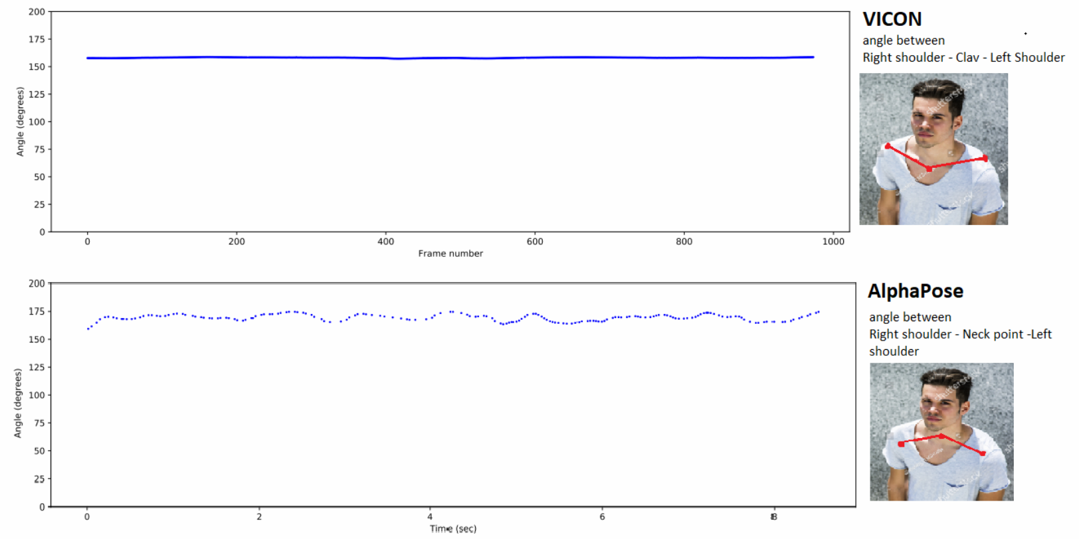
- Different markers
- Outer vs inner keypoints

Slide 13
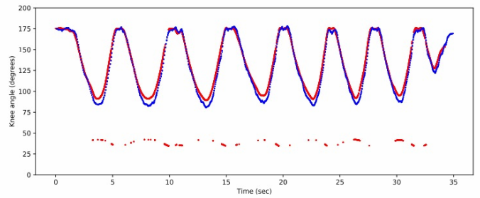
Current challanges
Matching Vicon data to OpenPose data
No timestamps output from Vicon
Subject doing squats, right knee angle (Vicon FPS estimation)
OpenPose Vicon

Slide 14
Current goal
Overcome our current challenges
Successfully analyze enough data to validate Realsense and OpenPose with Vicon system
Completing our project

